Slide 1
Simple Harmonic Motion & Elasticity
Chapter 10

Slide 2
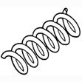


Elastic Potential Energy
What is it?
  Energy that is stored in elastic materials as a result of their stretching.
Where is it found?
  Rubber bands
  Bungee cords
  Trampolines
  Springs
  Bow and Arrow
  Guitar string
  Tennis Racquet

Slide 3
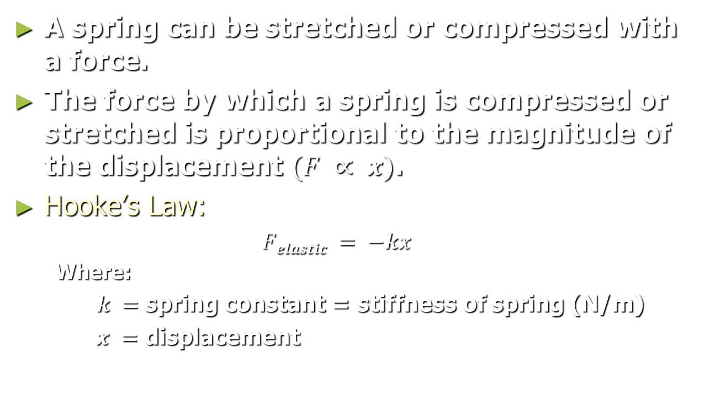
Hooke’s Law
A spring can be stretched or compressed with a force.
The force by which a spring is compressed or stretched is proportional to the magnitude of the displacement $(F ∝ x)$.
Hooke’s Law:
  $Felastic = −kx$
  Where:
  $k =$ spring constant = stiffness of spring (N/m)
  $x =$ displacement

Slide 4

Hooke’s Law
What is the graphical relationship between the elastic spring force and displacement?
  $Felastic = −kx$
Slope = k
Force
Displacement

Slide 5
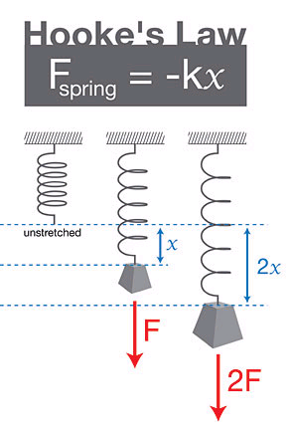
Hooke’s Law
A force acting on a spring, whether stretching or compressing, is always positive.
  Since the spring would prefer to be in a “relaxed” position, a negative “restoring” force will exist whenever it is deformed.
  The restoring force will always attempt to bring the spring and any object attached to it back to the equilibrium position.
  Hence, the restoring force is always negative.

Slide 6
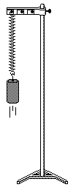
Example 1:
A 0.55 kg mass is attached to a vertical spring. If the spring is stretched 2.0 cm from its original position, what is the spring constant?
Known:
  m = 0.55 kg
  x = 2.0 cm
  g = 9.81 m/s²
Equations:
  F_{net} = 0 = F_{elastic} - F_{g} (1)
  F_{elastic} = kx (2)
  F_{g} = mg (3)
  Substituting 2 and 3 into 1 yields:
  k = -mg/x
  k = (0.55 kg)(9.81 m/s²)/(0.020 m)
  k = 270 N/m
F_{elastic}
F_{g}

Slide 7

Elastic Potential Energy in a Spring
Whenever a force is exerted on a spring to put it in tension or compression, work is being done on the spring.
  At the same time, energy is being stored in the spring.
  Hence the spring will have Elastic Potential Energy.
Analogous to kinetic energy:
  PE_{elastic} = ½ kx²

Slide 8
Example 2:
A 0.55 kg mass is attached to a vertical spring with a spring constant of 270 N/m. If the spring is stretched 4.0 cm from its original position, what is the Elastic Potential Energy?
Known:
  m = 0.55 kg
  x = 4.0 cm
  k = 270 N/m
  g = 9.81 m/s²
Equations:
  PE_{elastic} = ½ kx²
  PE_{elastic} = ½ (270 N/m)(0.04 m)²
  PE_{elastic} = 0.22 J
F_{elastic}
F_{g}

Slide 9

Elastic Potential Energy
What is area under the curve?
$$A = ½ bh$$
$$A = ½ xF$$
$$A = ½ xkx$$
$$A = ½ kx2$$
Which you should see equals the elastic potential energy
Force
Displacement(x)
Note that the force to compress or stretch a spring is not constant.

Slide 10





Example 3:
The spring constant of a toy dart gun is 180 N/m. If the spring is compressed 4.0 cm from its original position, what will be the speed of a 0.006 kg dart when it exits the gun, assuming that friction is negligible?
Known:
  m = 0.006 kg
  x = 4.0 cm
  k = 180 N/m
Use Conservation of Energy:
$$PEelastic = KEf$$
$$½ kx2 = ½ mv2$$
$$v = \sqrt{\frac{kx2}{m}}$$
$$v = \sqrt{\frac{(180\frac{N}{m})(0.04m)2}{0.006 kg}}$$
$$v =6.9m/s$$

Slide 11
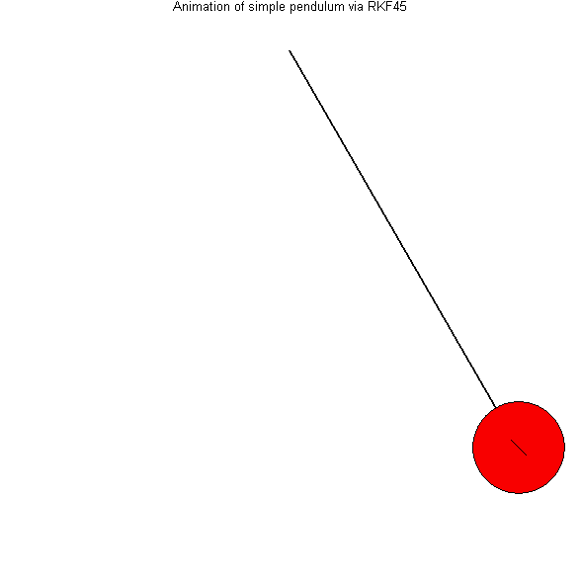
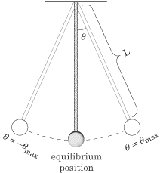
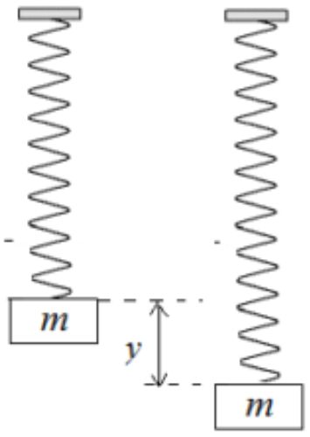
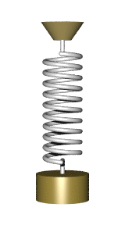
What is Simple Harmonic Motion?
Simple harmonic motion is characterized by oscillatory motion around an equilibrium position.
Simple harmonic motion exists whenever there is a restoring force acting on an object.
  The restoring force acts to bring the object back to an equilibrium position where the potential energy of the system is at a minimum.
Simple Pendulum
Mass on a Spring

Slide 12
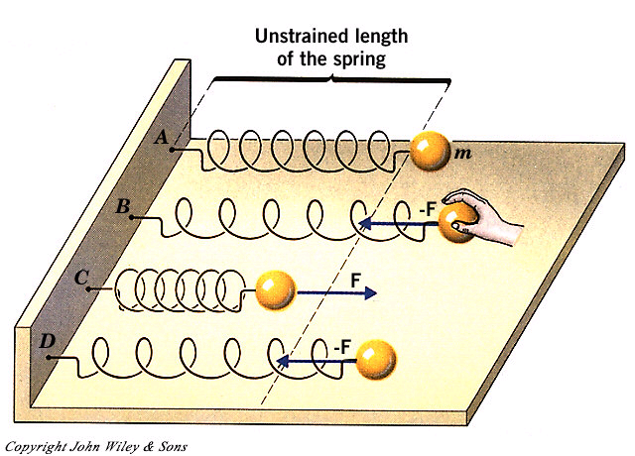
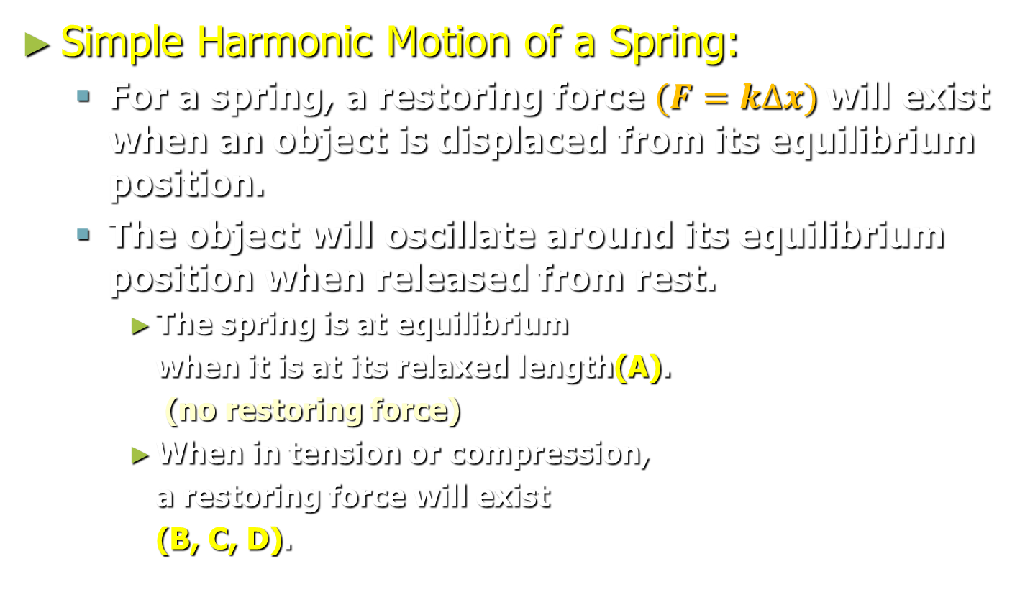
Simple Harmonic Motion & Springs
Simple Harmonic Motion of a Spring:
  For a spring, a restoring force $(F=k∆x)$will exist when an object is displaced from its equilibrium position.
  The object will oscillate around its equilibrium position when released from rest.
    The spring is at equilibrium
    when it is at its relaxed length(A).
    (no restoring force)
    When in tension or compression,
    a restoring force will exist
    (B, C, D).

Slide 13
Simple Harmonic Motion & Springs
At maximum displacement (+ x):
  The Elastic Potential Energy will be at a maximum
  The force will be at a maximum.
  The acceleration will be at a maximum.
At equilibrium (x = 0):
  The Elastic Potential Energy will be zero
  Velocity will be at a maximum.
  Kinetic Energy will be at a maximum
  The acceleration will be zero, as will the unbalanced restoring force.

Slide 14
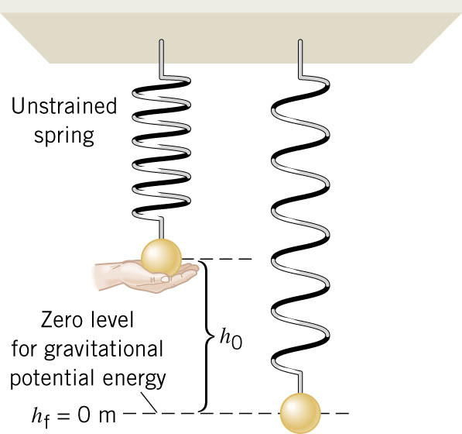
10.3 Energy and Simple Harmonic Motion
Example 3 Changing the Mass of a Simple Harmonic Oscilator
A 0.20-kg ball is attached to a vertical spring. The spring constant is 28 N/m. When released from rest, how far does the ball fall before being brought to a momentary stop by the spring?

Slide 15
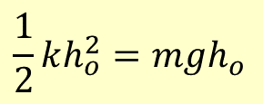


10.3 Energy and Simple Harmonic Motion
$$\frac{1}{2}mv_{f}^{2}+\frac{1}{2}Iω_{f}^{2}+mgh_{f}+\frac{1}{2}ky_{f}^{2}=\frac{1}{2}mv_{o}^{2}+\frac{1}{2}Iω_{o}^{2}+mgh_{o}+\frac{1}{2}ky_{o}^{2}$$
Since $y_{f}=h_{o}$
$$\frac{1}{2}kh_{o}^{2}=mgh_{o}$$
$$y_{o}$$
$$y_{f}$$

Slide 16
Frequency of Oscillation
For a spring oscillating system, the frequency and period of oscillation can be represented by the following equations:
    Therefore, if the mass of the spring and the spring constant are known, we can find the frequency and period at which the spring will oscillate.
  Large k and small mass equals high frequency of oscillation (A small stiff spring).

Slide 17
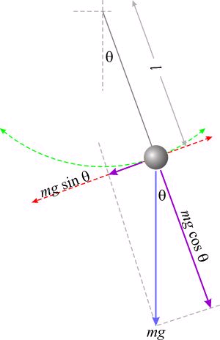
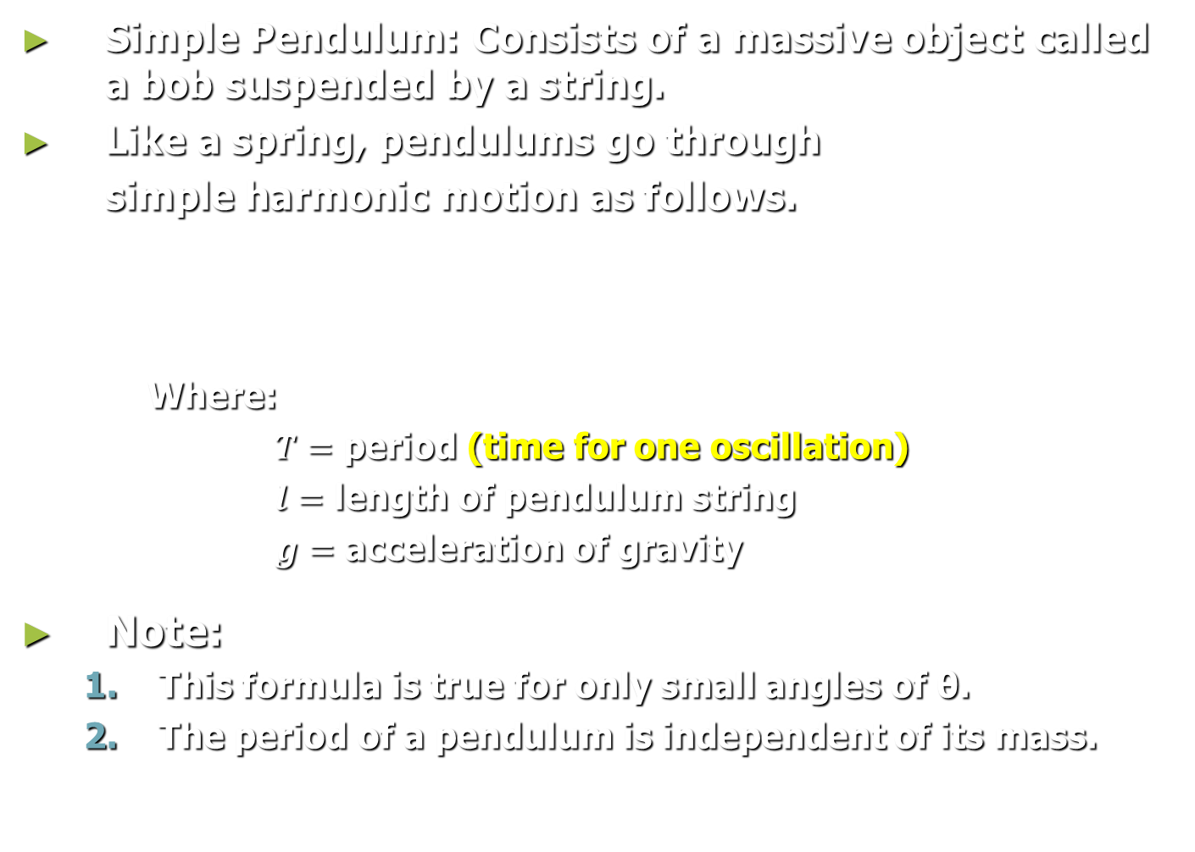


Harmonic Motion & The Simple Pendulum
Simple Pendulum: Consists of a massive object called a bob suspended by a string.
Like a spring, pendulums go through
simple harmonic motion as follows.
Where:
        $T=$ period (time for one oscillation)
        $l=$ length of pendulum string
        $g=$ acceleration of gravity
Note:
  This formula is true for only small angles of θ.
  The period of a pendulum is independent of its mass.
T=2$π\sqrt{\frac{l}{g}}$

Slide 18
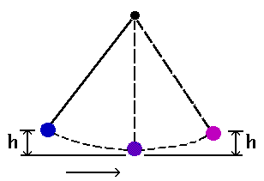
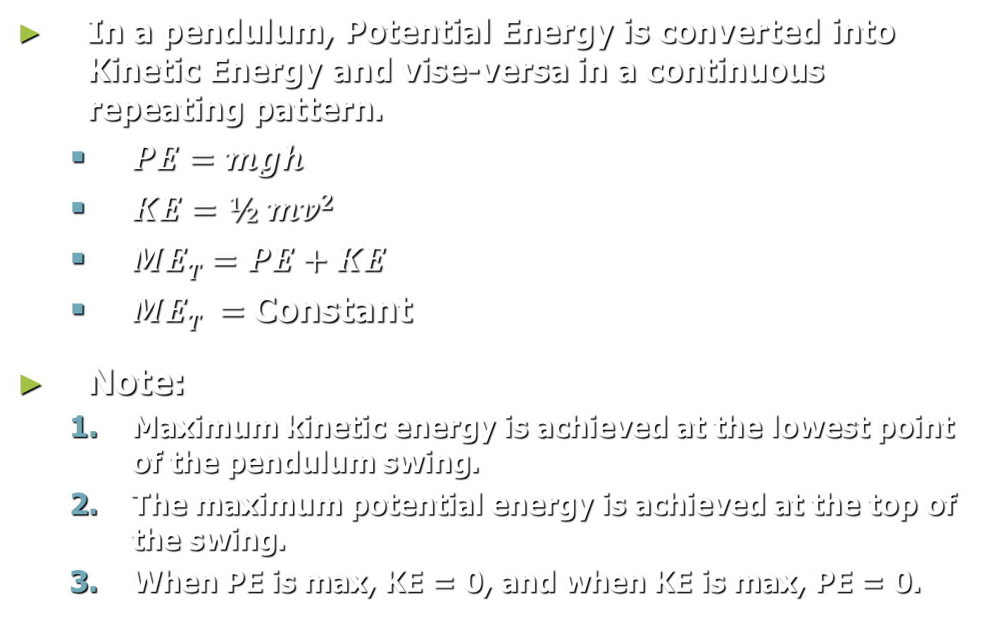
Conservation of ME & The Pendulum
In a pendulum, Potential Energy is converted into Kinetic Energy and vise-versa in a continuous repeating pattern.
  $PE=mgh$
  $KE=½ mv2$
  $MET=PE+KE$
  $MET =$Constant
Note:
  Maximum kinetic energy is achieved at the lowest point of the pendulum swing.
  The maximum potential energy is achieved at the top of the swing.
  When PE is max, KE = 0, and when KE is max, PE = 0.

Slide 19
Key Ideas
Elastic Potential Energy is the energy stored in a spring or other elastic material.
Hooke’s Law: The displacement of a spring from its unstretched position is proportional the force applied.
The slope of a force vs. displacement graph is equal to the spring constant.
The area under a force vs. displacement graph is equal to the work done to compress or stretch a spring.

Slide 20
Key Ideas
Springs and pendulums will go through oscillatory motion when displaced from an equilibrium position.
The period of oscillation of a simple pendulum is independent of its angle of displacement (small angles) and mass.
Conservation of energy: Energy can be converted from one form to another, but it is always conserved.

Slide 21
Example 2:
What is the difference in the elastic potential energy of the system when the deflection is maximum in either the positive or negative direction?
A 0.55 kg mass is attached to a vertical spring with a spring constant of 270 N/m. If the spring is stretched 4.0 cm from its original position, what is the Elastic Potential Energy?
Known:
  m = 0.55 kg
  x = 4.0 cm
  k = 270 N/m
  g = 9.81 m/s²
Equations:
  PE_{elastic} = ½ kx²
  PE_{elastic} = ½ (270 N/m)(0.04 m)²
  PE_{elastic} = 0.22 J
F_{elastic}
F_{g}

Slide 22
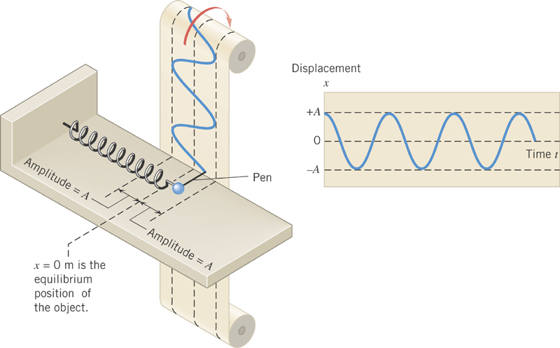
Simple Harmonic Motion of Springs
Oscillating systems such as that of a spring follow a sinusoidal wave pattern.
Harmonic Motion of Springs – 1
Harmonic Motion of Springs (Concept Simulator)

